Slide 1


E-Commerce Management System
Target 2.0
Course: DAMG6210 Professor: Simon Wang Project Team3: Yang Zheng, Mengyun Xie, Chenni Xu

Slide 2




Database Implementation
DDL
Computed Column
Column Data Encryption
Table Level
Check Constraints
Stored Procedures
Trigger
DML
Views

Slide 3
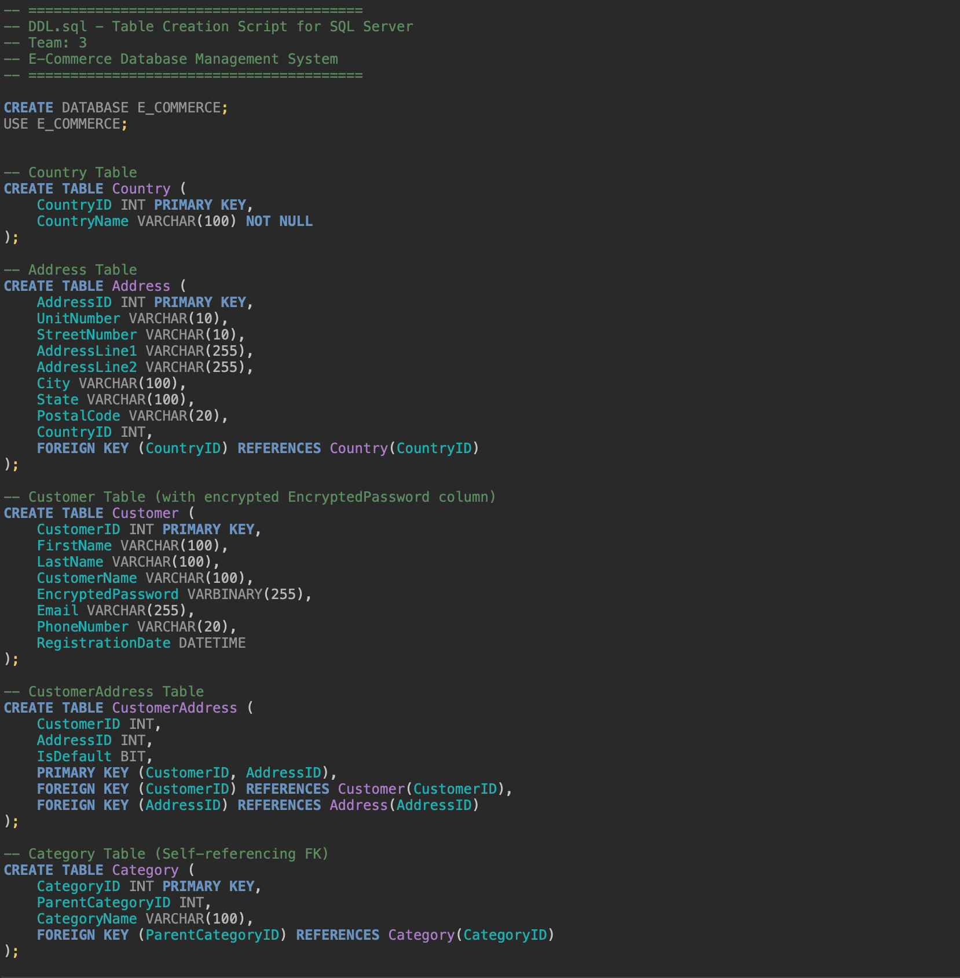

DDL.SQL
DATA DEFINITION LANGUAGE
Country
Address
Customer
CustomerAddress
Category
Product
ProductItem
ShoppingCart
ShoppingCartItem
PaymentType
PaymentMethod
ShippingMethod
OrderStatus
ShopOrder
Coupon
CouponCategory
OrderLine
Review
TicketStatus
CustomerSupportTicket
Notes:
Defines the complete database schema for the Target 2.0 E-Commerce Management System.
Creates a database named E_COMMERCE.
Defines 20+ tables according to the E-R diagram.
Uses appropriate SQL data types and integrity constraints.

Slide 4
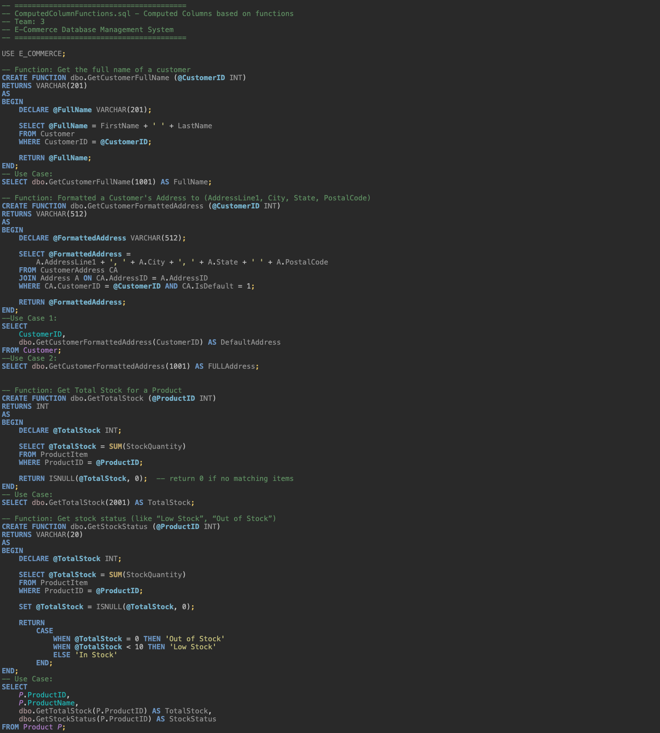
ComputedColumn.SQL
GetCustomerFullName(CustomerID)
GetCustomerFormattedAddress(CustomerID)
GetTotalStock(ProductID)
GetStockStatus(ProductID)
GetTop5BestSellers()
GetOrderGrandTotal(OrderID)
GetUnsolvedTickets()
Notes:
Implements functions that provide calculated values based on existing data to simplify querying and maintain consistency.
• GetCustomerFullName(CustomerID) – Returns a customer’s full name.
• GetCustomerFormattedAddress(CustomerID) – Formats the customer’s default address.
• GetTotalStock(ProductID) – Calculates total stock quantity for a product.
• GetStockStatus(ProductID) – Returns stock status like “In Stock”, “Low Stock”, or “Out of Stock”.
• GetTop5BestSellers() – Returns a table of top 5 best-selling products.
• GetOrderGrandTotal(OrderID) – Computes grand total for an order with coupon
discounts.
• GetUnsolvedTickets() – Returns a table of unresolved customer support tickets.

Slide 5
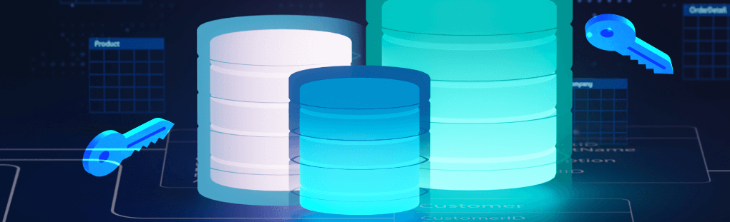
ColumnDataEncryption.SQL
Sensitive Data Protection
Notes:
Secures sensitive customer and transactional data through encryption.
• Creates a Master Key encrypted by a password.
• Creates a Certificate used to encrypt symmetric keys.
• Creates a Symmetric Key to encrypt/decrypt column data such as passwords.

Slide 6
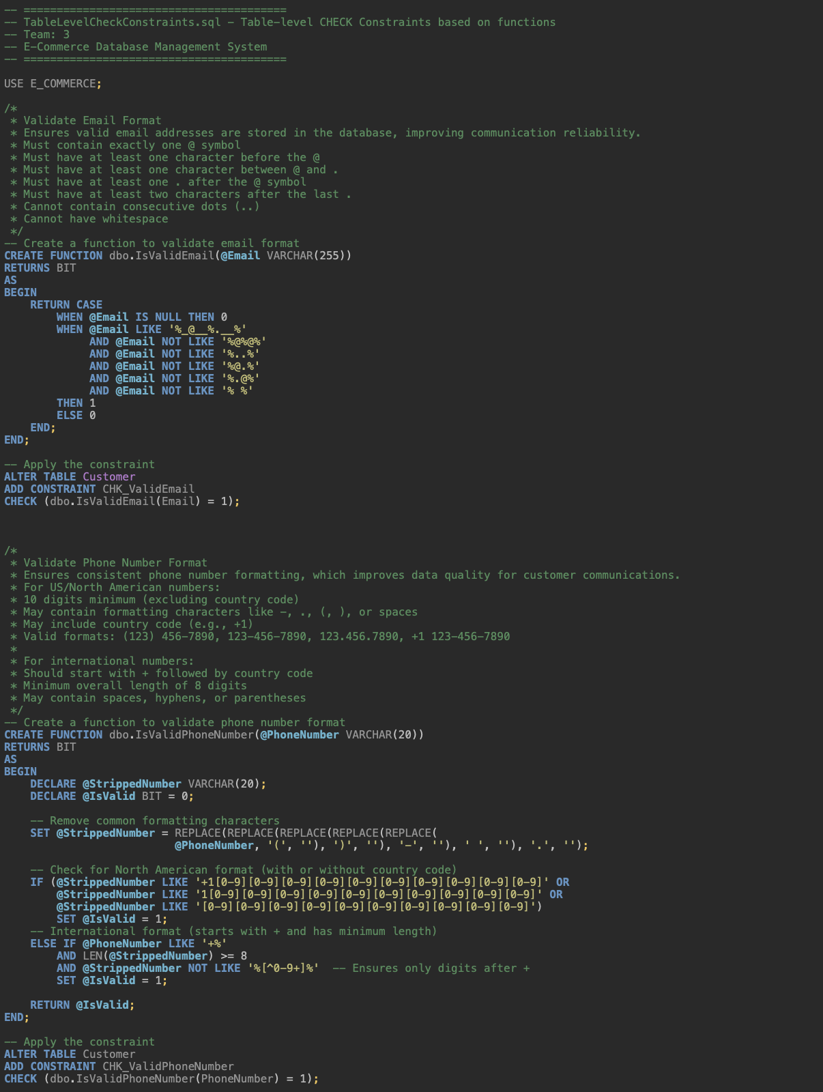
TableLevelCheckConstraints.SQL
IsValidEmail
* Must contain exactly one @ symbol
* Must have at least one character before the @
* Must have at least one character between @ and .
* Must have at least one . after the @ symbol
* Must have at least two characters after the last .
* Cannot contain consecutive dots (..)
* Cannot have whitespace
IsValidPhoneNumber
For US/North American numbers:
* 10 digits minimum (excluding country code)
* May contain formatting characters like -, ., (, ), or spaces
* May include country code (e.g., +1)
* Valid formats: (123) 456-7890, 123-456-7890, 123.456.7890, +1 123-456-7890
For international numbers:
* Should start with + followed by country code
* Minimum overall length of 8 digits
* May contain spaces, hyphens, or parentheses
Notes:
Adds SQL functions for enforcing data format and validation via check constraints.
• IsValidEmail() – Validates email format. Ensures valid email addresses are stored in the database, improving communication reliability.
• IsValidPhoneNumber() – Validates phone number format. Ensures consistent phone number formatting, which improves data quality for customer communications.

Slide 7

Thank You!

Slide 8
Key Features
PRECISE AND SECURE OPERATIONS
STREAMLINED PROCESSES
BUSINESS GROWTH AND INNOVATION
The system ensures precise, secure, and real-time operations for both customers and administrators, providing a level of trust and confidence in the e-commerce experience.
The system simplifies complex processes, making it easier for customers to navigate and for administrators to manage orders, inventory, and logistics.
By prioritizing security, scalability, and innovation, the Target 2.0 E-Commerce Management System empowers businesses to drive growth, explore new opportunities, and deliver exceptional digital retail experiences.
CUSTOMER-CENTRIC APPROACH
REAL-TIME INSIGHTS
The system is designed with the customer in mind, creating a seamless and trusted shopping experience that builds brand loyalty and fosters long-term relationships.
The system provides a range of real-time data visualization dashboards, enabling businesses to make informed decisions and respond quickly to changing market conditions.

Slide 9
Overview
REDEFINE ONLINE SHOPPING EXPERIENCE
Target 2.0 E-Commerce Management System aims to transform the digital retail landscape through seamless management of customer, order, product, coupon, and logistics data.
ENSURE PRECISE, SECURE, AND REAL-TIME OPERATIONS
The system creates trust, simplifies processes, and enables business growth and innovation for both customers and administrators.
EXPERIENCED DEVELOPMENT TEAM
The project team behind Target 2.0 consists of Yang Zheng, Mengyun Xie, and Chenni Xu, bringing their expertise in database management and e-commerce solutions.
COMPREHENSIVE DATABASE MANAGEMENT
The system's database design includes an ERD, DDL, computed columns, data encryption, table constraints, stored procedures, triggers, and DML.
PROVIDE REAL-TIME INSIGHTS AND VISUALIZATIONS
The system offers a range of data visualization dashboards, including Coupon Discount Impact, Customer Insights, Customer Support, Inventory, Product Ratings, and Sales.

Slide 10









Target 2.0 Objectives
BUILD TRUST
Establish confidence with customers through secure and transparent operations
SIMPLIFY PROCESSES
Streamline e-commerce workflows for seamless customer and admin experiences
PROVIDE SCALABILITY
Accommodate growing business demands and enable continued innovation
ENABLE GROWTH
Empower businesses to thrive in the digital retail landscape

Slide 11







Aligning Target 2.0 with Corporate Objectives
STRATEGIC GOALS
Ensuring e-commerce platform supports overall business strategy
CUSTOMER FOCUS
Enhancing online experience to drive customer satisfaction
OPERATIONAL EFFICIENCY
Optimizing database management to improve business operations
GROWTH OPPORTUNITIES
Leveraging e-commerce platform to expand market reach

Slide 12


Key Milestones in Target 2.0 Development
2019
2015
Deployment of advanced data analytics and AI-driven personalization
2022
Launch of Target 2.0: Complete overhaul of Target's e-commerce platform
Introduction of real-time inventory management and order fulfillment
2021
2017
Expansion of omnichannel capabilities, integrating in-store and online experiences
Adoption of cloud-based infrastructure for scalability and reliability

Slide 13




The Evolution of Target 2.0
OMNICHANNEL EXPANSION
Bridging the gap between online and in-store
MOBILE INTEGRATION
END
Optimizing the experience for mobile shoppers
SUSTAINABILITY INITIATIVES
DATA ANALYTICS INTEGRATION
Integrating eco-friendly practices into the platform
Leveraging data to enhance customer experience
AI-POWERED RECOMMENDATIONS
Implementing machine learning for personalized suggestions
LOGISTICS OPTIMIZATION
E-COMMERCE LAUNCH
Target's first e-commerce platform debut
Streamlining inventory management and fulfillment
START

Slide 14
Pillars of the Target 2.0 Database System
SCALABILITY
DATA INTEGRITY
REAL-TIME ANALYTICS
Highly scalable architecture to handle growing transaction volumes and user traffic on Target.com
Robust data management processes to ensure accurate, consistent, and reliable product information and customer data
Advanced analytics capabilities to generate insights and drive data-driven decision-making
OMNICHANNEL INTEGRATION
SECURITY AND COMPLIANCE
Seamless integration with in-store systems and other customer touchpoints for a cohesive shopping experience
Robust security measures and adherence to industry regulations to protect customer data and transactions

Slide 15
Database Design
ENTITY-RELATIONSHIP DIAGRAM (ERD)
Graphical representation of the database schema, depicting the entities, their attributes, and the relationships between them.
DATA DEFINITION LANGUAGE (DDL)
SQL statements used to create and define the structure of the database, including tables, columns, and their data types.
COMPUTED COLUMNS
Columns whose values are derived from other columns or expressions, providing calculated data within the database.
COLUMN DATA ENCRYPTION
Implementation of advanced encryption techniques to protect sensitive customer and financial information stored in the database.
TABLE-LEVEL CONSTRAINTS
Enforcement of business rules and data integrity through the use of check constraints, foreign key constraints, and other table-level constraints.
STORED PROCEDURES
Reusable SQL code that encapsulates business logic and can be called from applications, improving performance and maintainability.
TRIGGERS
Automated actions triggered by specific events, such as data modifications, to ensure data consistency and maintain business rules.
DATA MANIPULATION LANGUAGE (DML)
SQL statements used to insert, update, and delete data within the database, often utilizing the stored procedures.

Slide 16



Target 2.0 Features
SEAMLESS MANAGEMENT
PRECISION AND SECURITY
REAL-TIME INSIGHTS
The Target 2.0 E-Commerce Management System offers seamless integration and management of critical e-commerce data, including customers, orders, products, coupons, and logistics.
The system ensures precise, secure, and real-time operations for both customers and administrators, prioritizing data integrity and protecting sensitive information.
The system provides real-time insights and analytics, enabling businesses to make informed decisions and deliver exceptional digital retail experiences.

Slide 17






Optimizing the Customer Journey on Target 2.0
1
PRODUCT DISCOVERY
2
ADD TO CART
3
CHECKOUT PROCESS
4
ORDER FULFILLMENT
5
POST-PURCHASE EXPERIENCE
6
REPEAT BUSINESS

Slide 18





Scalability and Growth
1
DESIGNED TO ACCOMMODATE GROWING CUSTOMER DEMANDS
2
FLEXIBLE ARCHITECTURE TO SCALE WITH BUSINESS EXPANSION
3
EFFICIENT DATA MANAGEMENT FOR SEAMLESS OPERATIONS
4
INNOVATIVE FEATURES TO ENABLE CONTINUED GROWTH
5
EMPOWERING BUSINESSES TO ADAPT AND THRIVE

Slide 19
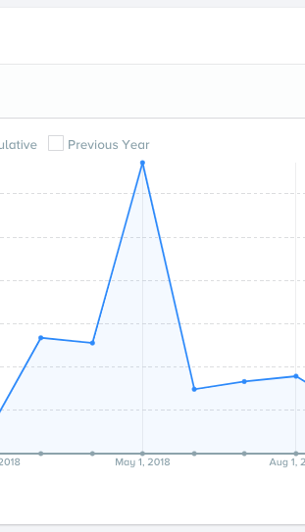
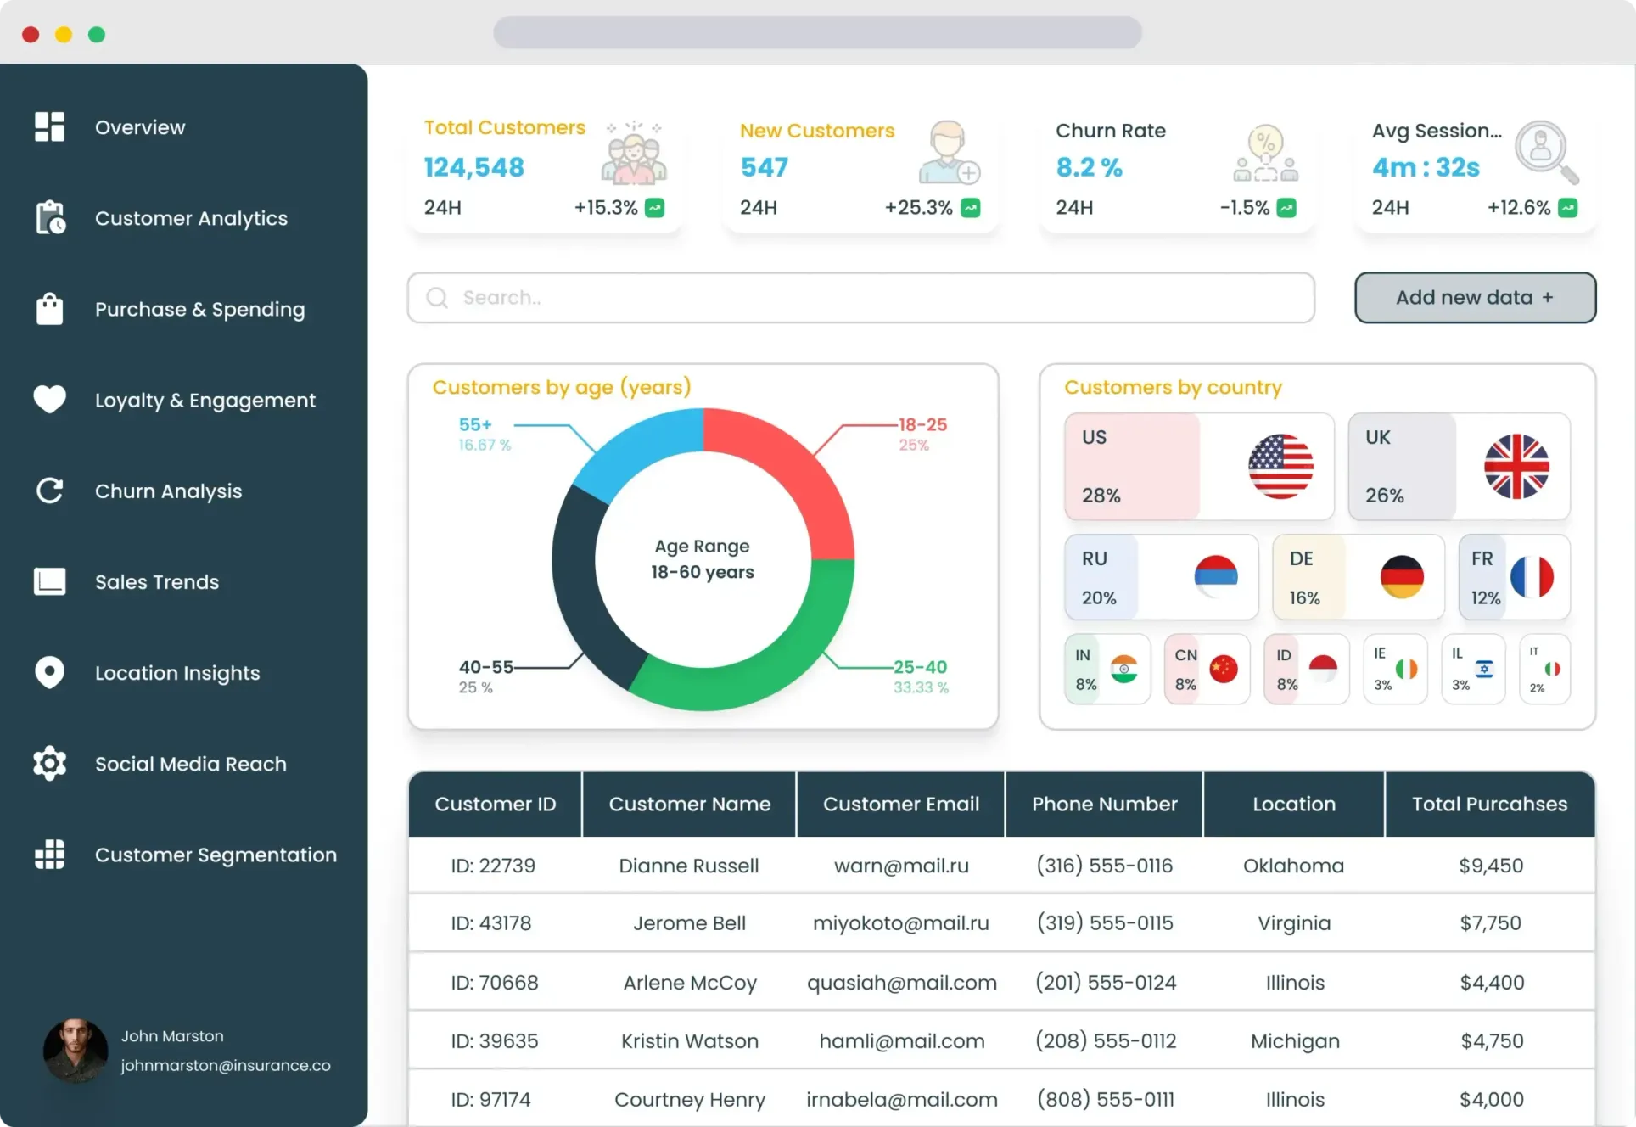
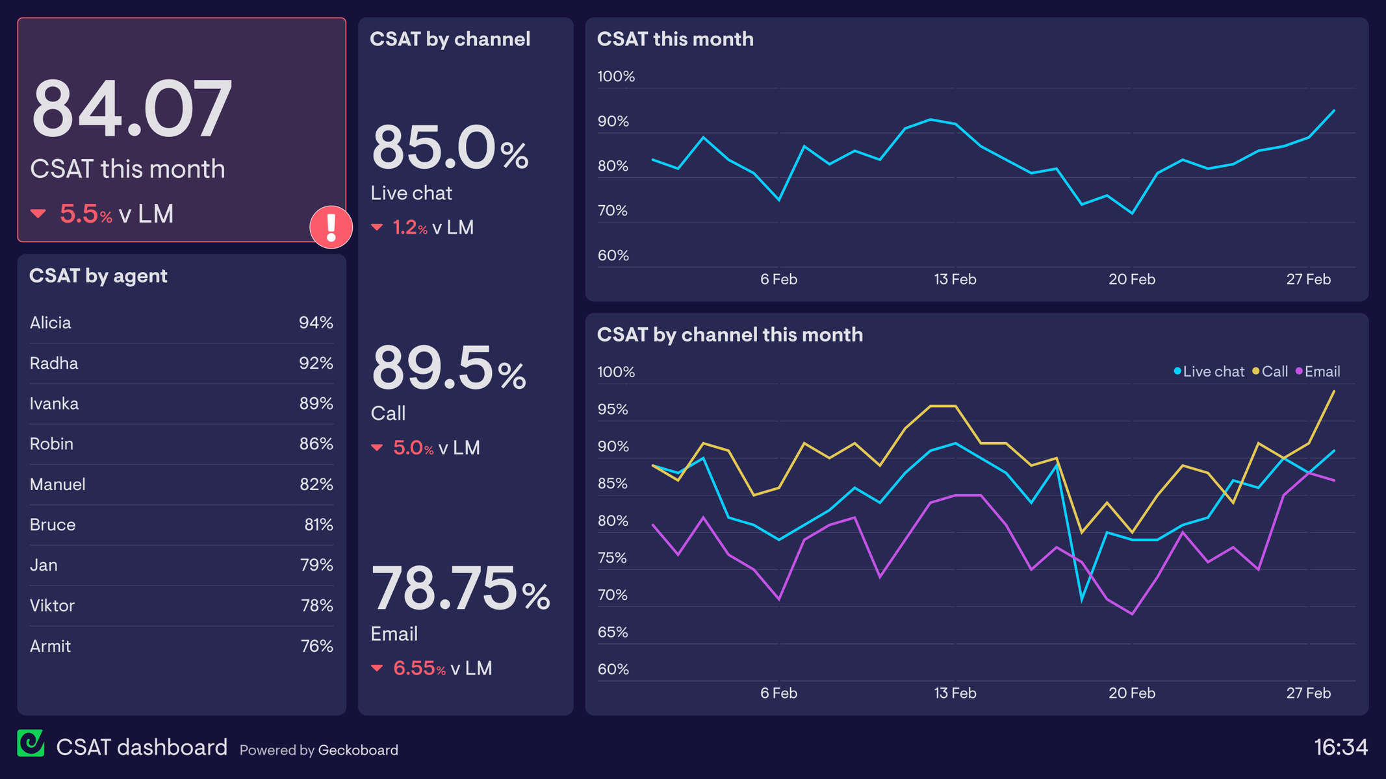
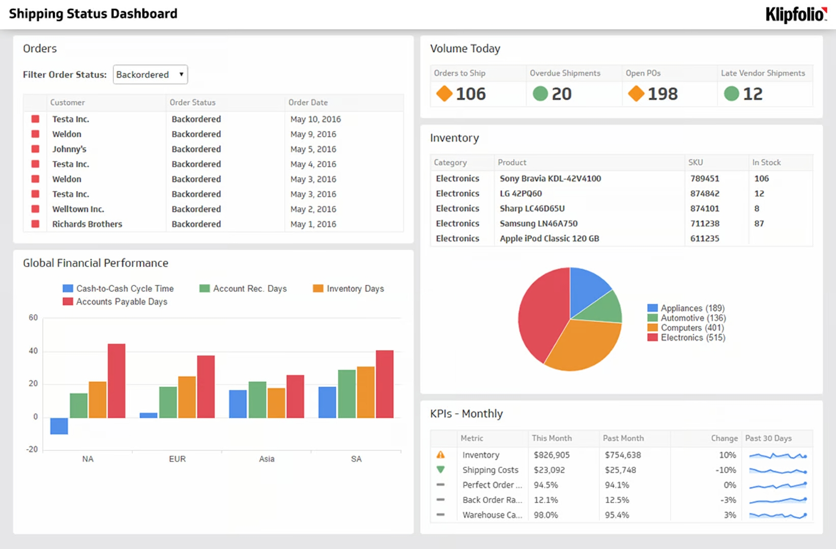
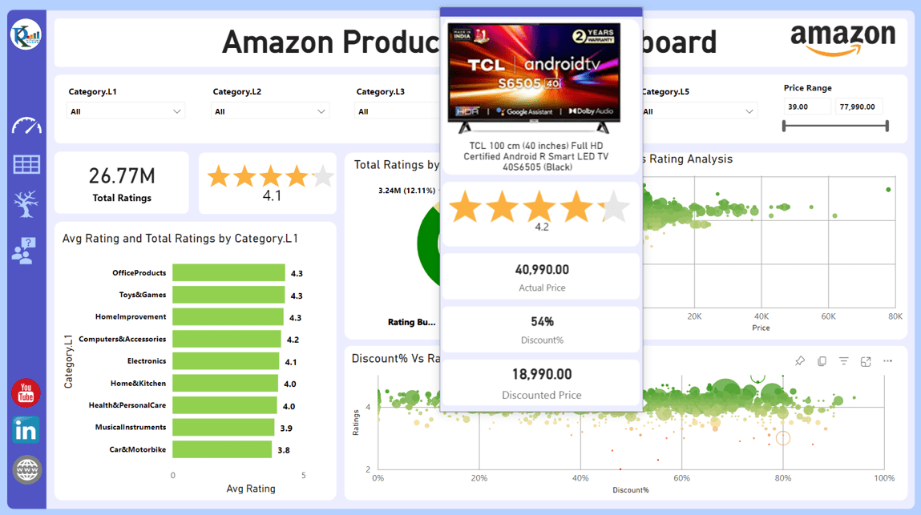
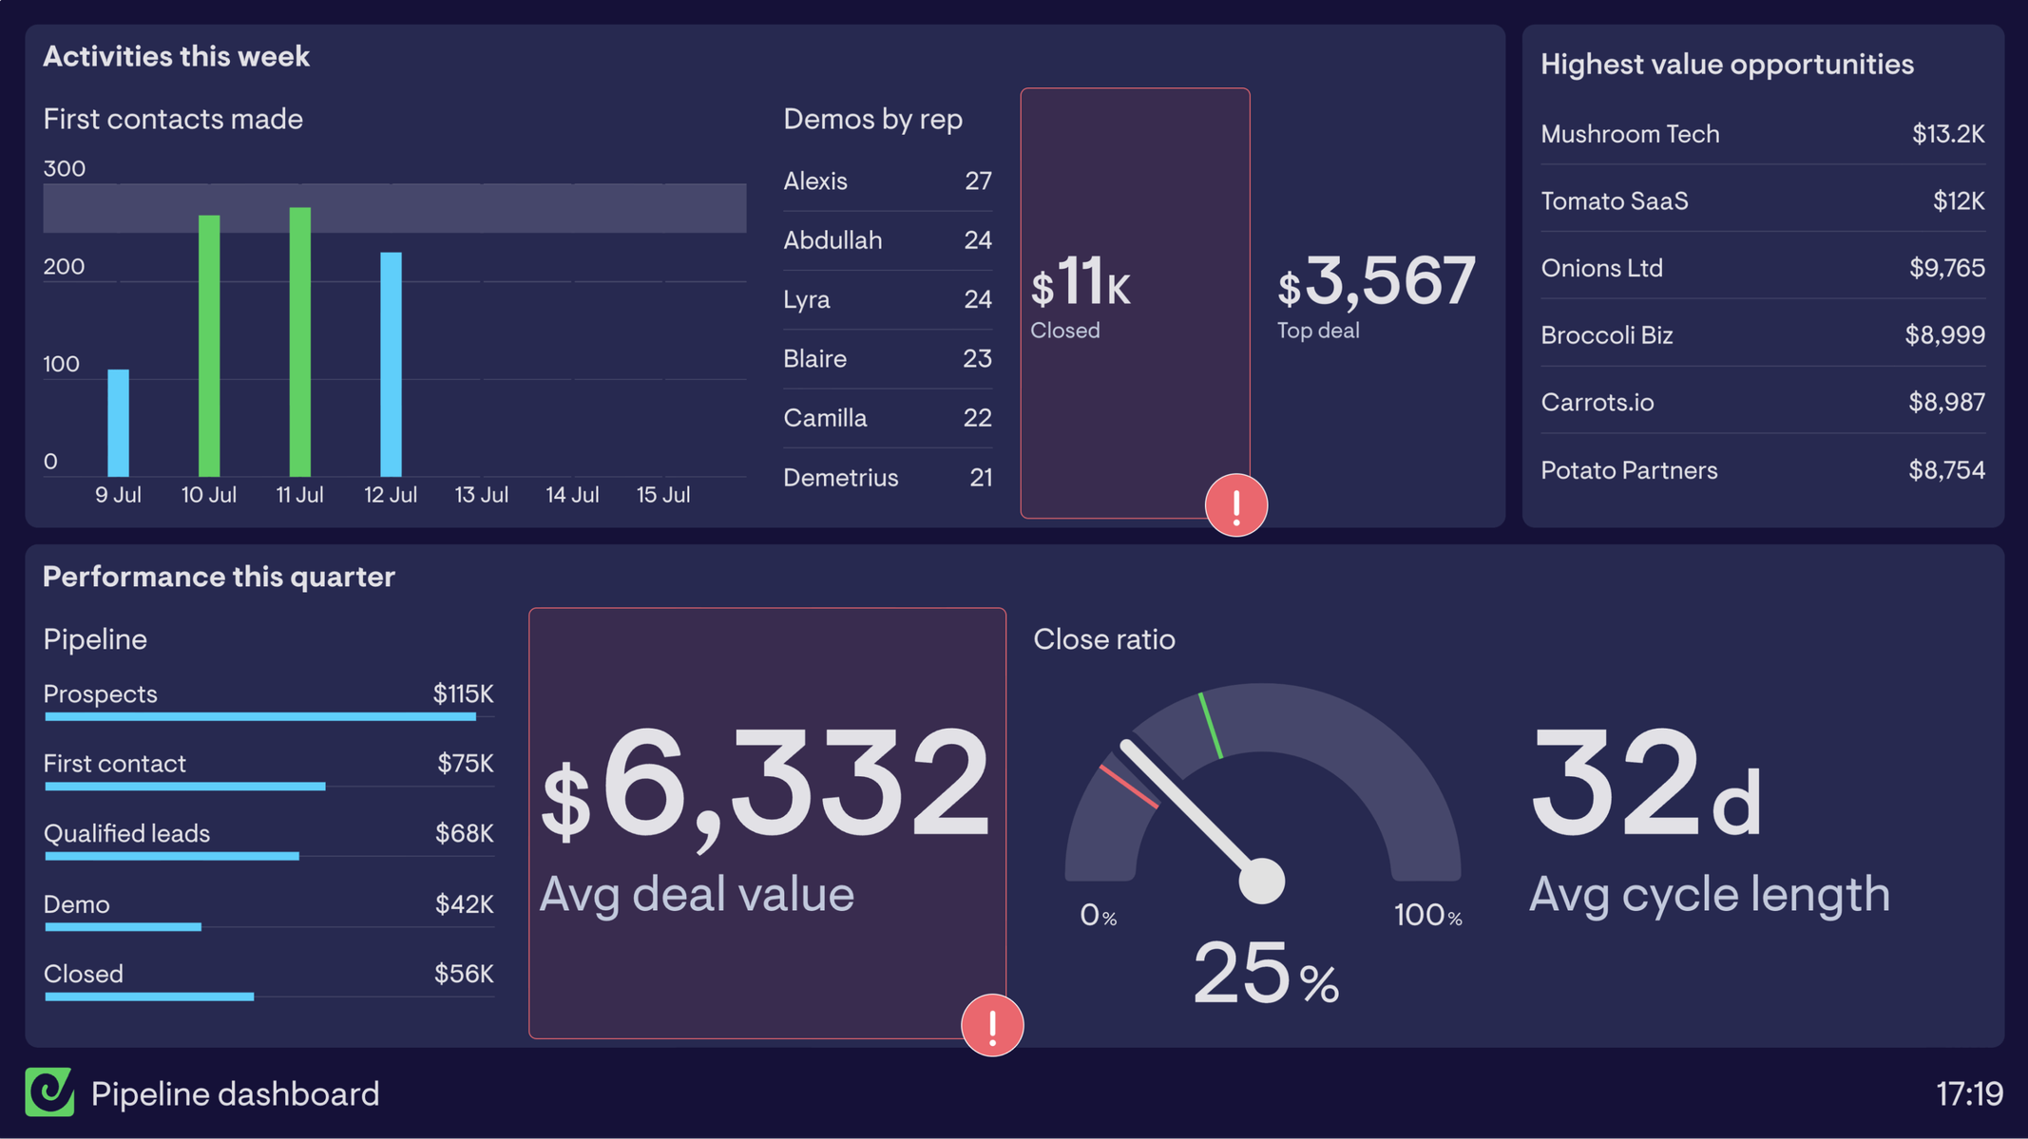
Real-Time Insights
COUPON DISCOUNT IMPACT
CUSTOMER INSIGHTS
CUSTOMER SUPPORT DASHBOARD
INVENTORY DASHBOARD
PRODUCT RATINGS DASHBOARD
SALES DASHBOARD
Tracking of sales performance, revenue, and key business metrics.
Visualization displaying the impact of coupons on sales and revenue.
Dashboards providing in-depth analysis of customer behavior and preferences.
Comprehensive view of product inventory levels, trends, and forecasting.
Visualizations of product ratings, reviews, and customer feedback.
Real-time monitoring of customer inquiries, issues, and response times.

Slide 20
“The Target 2.0 E-Commerce Management System represents a comprehensive and innovative solution that redefines the online shopping experience, empowering businesses to build trust, streamline operations, and drive growth in the digital retail landscape.”
E-COMMERCE (TARGET 2.0) DATABASE MANAGEMENT SYSTEM

